Slide 1

Language Translator using Python
Discover a powerful language translation tool built with Python, leveraging the Google Translate API and Tkinter to provide users with a seamless, one-click translation experience.
by Sarbjot Singh

Slide 2

Overview: Translating One Language to Another with a Simple Click
1
Instant Translations
2
Multilingual Support
3
Intuitive Interface
Translate text from one language to another with a single click, no complex setup required.
Accommodate a wide range of languages, empowering users to communicate effectively across linguistic barriers.
Seamless user experience with a clean and user-friendly graphical interface built using Tkinter.

Slide 3
Technology Used: Google Translate API and Tkinter
Google Translate API
Tkinter GUI
Python Integration
Leveraging the powerful language translation services provided by Google, offering accurate and reliable translations.
Implementing a clean and intuitive graphical user interface using the Tkinter toolkit, ensuring a smooth user experience.
Seamlessly integrating the Google Translate API and Tkinter within a Python-based application, optimizing performance and functionality.

Slide 4

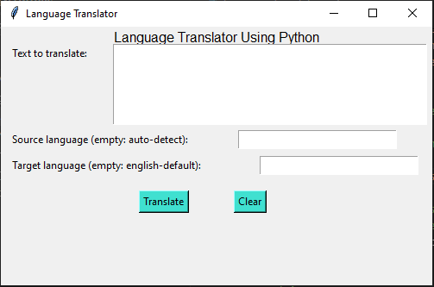
Project Objectives
User-Friendly Translation
Multilingual Support
Accommodate a wide range of languages, catering to users with diverse linguistic needs.
Provide users with a simple and efficient way to translate text from one language to another.
Rapid Response
Deployment Readiness
Deliver translations instantly, ensuring a seamless and efficient user experience.
Package the application for easy deployment, making it accessible to a wider audience.

Slide 5

User Input and Translation Process
User Input
Translation
Users enter the text they want to translate in the provided text field.
The application uses the Google Translate API to instantly provide the translated text.
1
2
3
Language Selection
Users select the source and target languages for the translation.

Slide 6
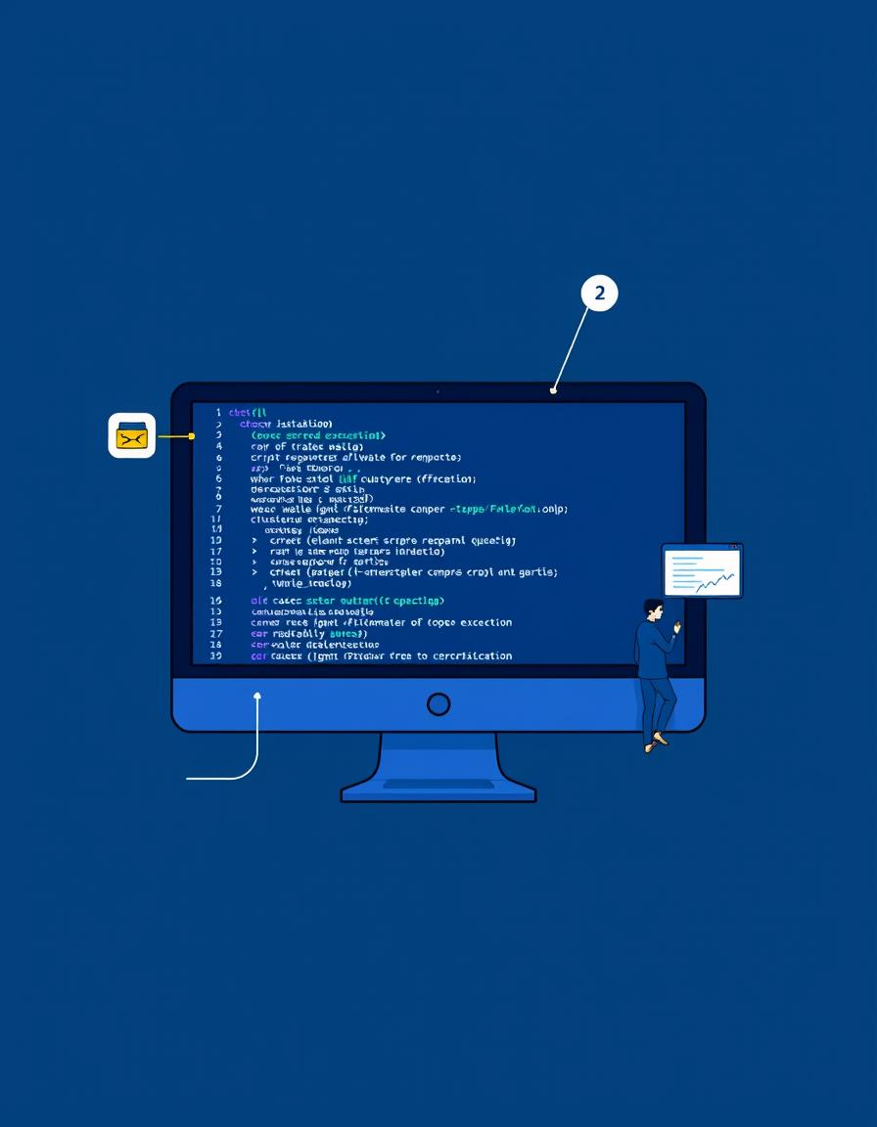
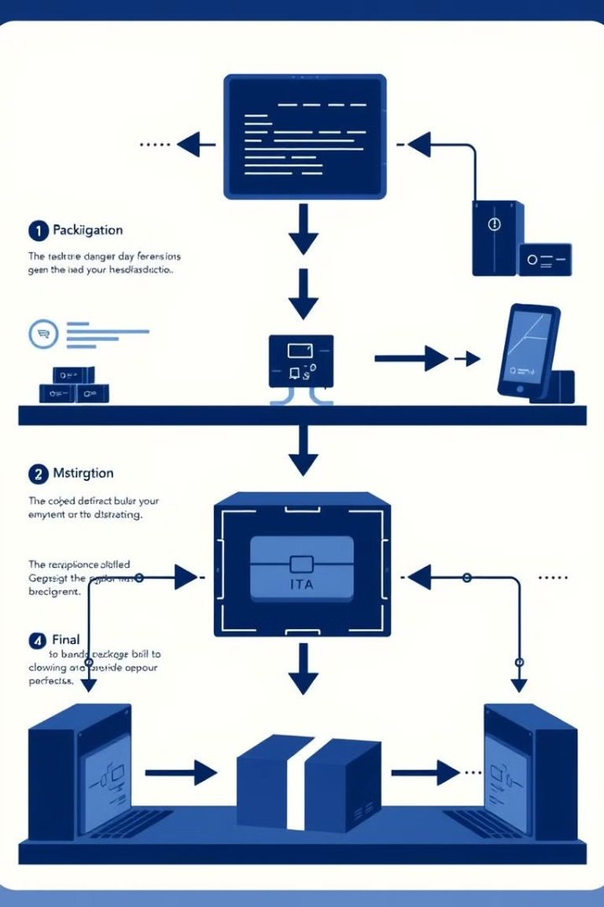



Execution Instructions
Prerequisites
Install Python on your system if it’s not already installed.
Install required libraries by running:
pip install googletrans==3.1.0a0
Running the Script
Open the code in an editor like VS Code or any Python IDE.
Run the script by pressing the "Run" button or by executing:
python script_name.py
Usage Instructions
Input text and specify source and target languages as prompted.
View the translated output displayed in the output area or message box

Slide 7





Application Benefits
Global Reach
Time-Saving
Cost-Effective
Accessibility
Enables communication across language barriers, fostering global collaboration and understanding.
Provides instant translations, saving users time and effort compared to manual translation methods.
Offers a free and accessible translation solution, eliminating the need for paid services.
Accessible to users with diverse linguistic backgrounds, promoting inclusion and understanding.

Slide 8
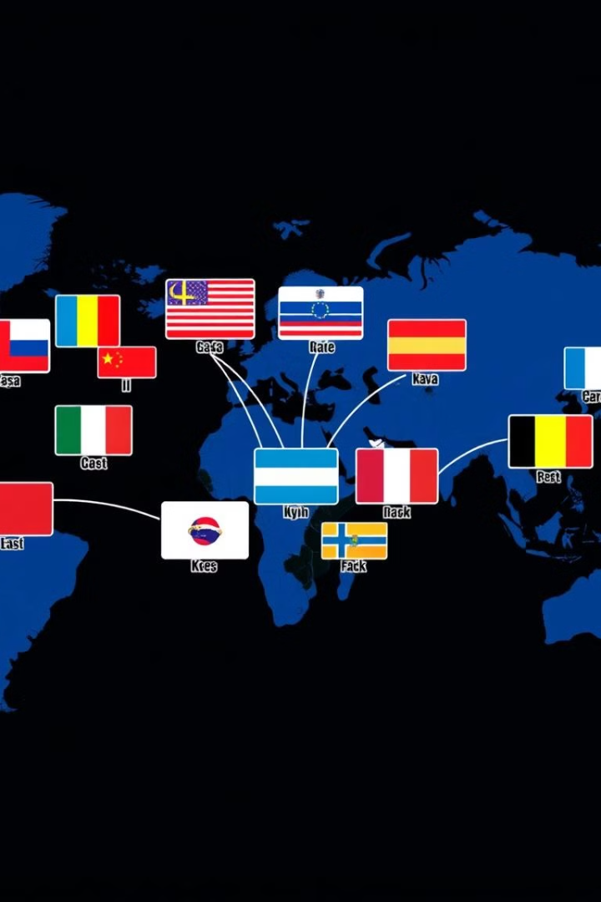
Handling Multiple Language Pairs
Source Language
Target Language
English
Spanish, French, German, Chinese, Japanese
Spanish
English, French
French
English, Spanish
German
English
Chinese
English
Japanese
English

Slide 9
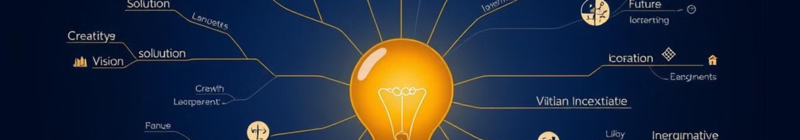
Potential Enhancements
1
Speech Recognition
2
Offline Mode
Integrate speech recognition capabilities to enable voice-based translations.
Develop an offline version of the translator, allowing users to translate without an internet connection.
3
Contextual Translations
4
Enhanced Error Handling
Enhance the translation quality by considering contextual information and providing more accurate translations.
Add checks to validate language codes and handle API errors.

Slide 10

Conclusion and Future Scope
The language translator application built with Python, Google Translate API, and Tkinter offers a powerful and accessible solution for users to translate text across a wide range of languages. With its user-friendly interface, instant translations, and deployment-ready packaging, this tool paves the way for seamless communication and collaboration in a multilingual world.
As technology continues to evolve, the future scope of this application includes expanding its capabilities, such as incorporating speech recognition, offline functionality, and advanced contextual translations, further enhancing the user experience and driving cross-cultural understanding.

